Slide 1
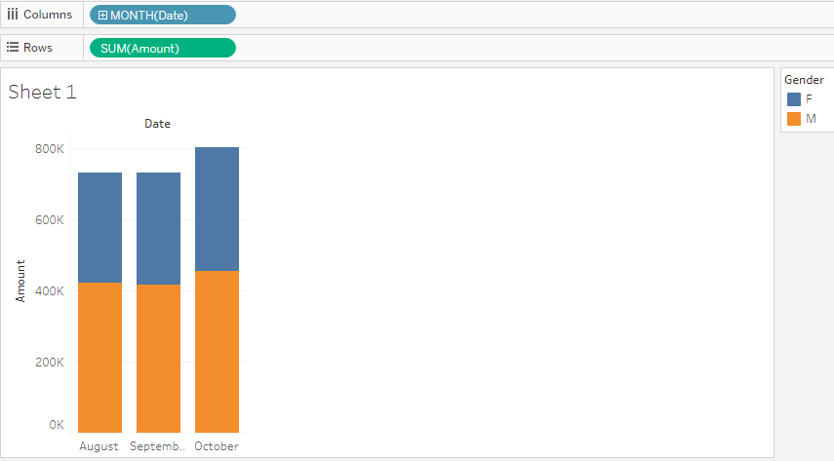
Gender wise amount collected every month (Male>Female)

Slide 2
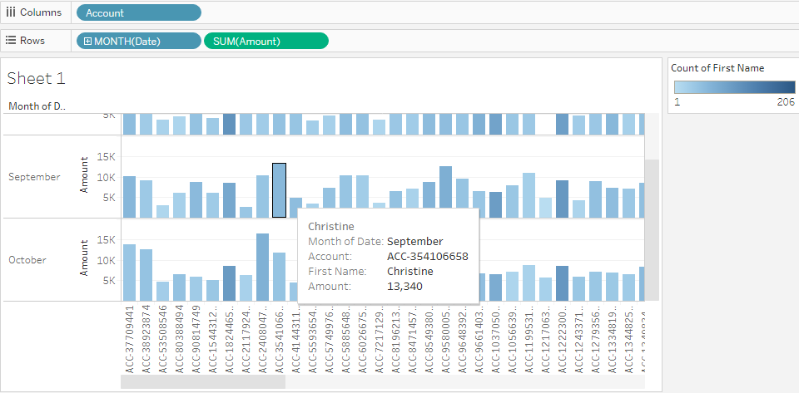
How much amount was collected from every account (color shows no. of times the account was used in a month)

Slide 3
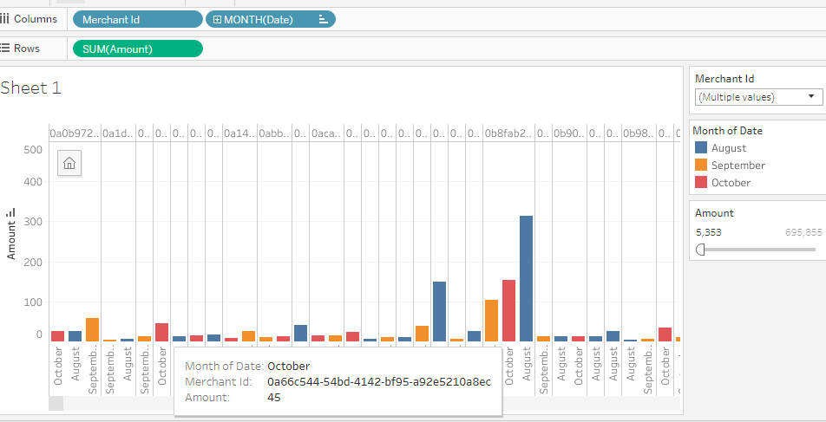
Revenue bought by each merchant each month. (Can filter amount, merchant ID)

